Slide 1
Bio-inspired Networking and Complex Networks: A Survey
Sheng-Yuan Tu

Slide 2
Outline
Challenges in future wireless networks
Bio-inspired networking
Example 1: ant colony
Example 2: immune system
Complex networks
Network measures
Network models
Phenomena in complex networks
Dynamical processes on complex networks
Further research topics

Slide 3
Challenges in Future Wireless Networks
Scalability
By 2020, there will be trillion wireless devices [1] (e.g. cell phone, laptop, health/safety care sensors, …)
Adaptation
Dynamic network condition and diverse user demand
Resilience
Robust to failure/malfunction of nodes and to intruders

Slide 4
Bio-inspired Networking
Biomimicry: studies designs and processes in nature and then mimics them in order to solve human problems [3]
A number of principles and mechanisms in large scale biological systems [2]
Self-organization: Patterns emerge, regulated by feedback loops, without existence of leader
Autonomous actions based on local information/interaction: Distributed computing with simple rule of thumb
Birth and death as expected events: Systems equip with self-regulation
Natural selection and evolution
Optimal solution in some sense
A special issue on bio-inspired networking will be published in IEEE JSAC in 2nd quarter 2010.

Slide 5
Bio-inspired Networking
Observation, verbal description
Math. Model (Diff. eq., prob. methods, fuzzy logic,…)
Entities mapping
Algorithm establishment
Parameter evaluation, prediction
Verification, hypothesis testing
Performance evaluation
Parameter
tuning
Biological Modeling
Engineering Applying

Slide 6
Example 1: Foraging of Ant Colony
Stigmergy: interaction between ants is built on trail pheromone [6]
Behaviors [6]:
Lay pheromone in both directions between food source and nest
Amount of pheromone when go back to nest is according to richness of food source (explore richest resource)
Pheromone intensity decreases over time due to evaporation
Stochastic model (no trail-laying in backward):

Slide 7
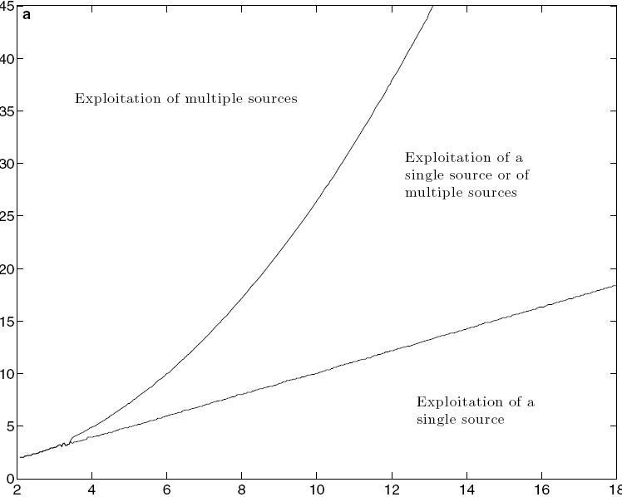
Example 1: Foraging of Ant Colony
Parameter evaluation:
Ω: flux of ants
q: amount of pheromone laying
f: rate of pheromone evaporation
k: attractiveness of an unmarked path
n: degree of nonlinearity of the choice
Shortest path search
[5]

Slide 8
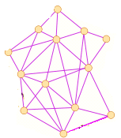
Example 1: Foraging of Ant Colony
Application in ad-hoc network routing [4]
Modified behaviors
Probabilistic solution construction without forward pheromone updating
Deterministic backward path with loop elimination and pheromone updating
Pheromone updates based on solution quality
Pheromone evaporation (balance between exploration and exploitation)

Slide 9
Example 1: Foraging of Ant Colony
Algorithm
Initiation
Path selection
Pheromone update
More other applications can be found in swarm intelligence [7].

Slide 10
Example 2: Immune System
Functional architecture of the IS [8]
Physical barriers: skin, mucous membranes of digestive, respiratory, and reproductive tracts
Innate immune system: macrophages cells, complement proteins, and natural killer cells against common pathogen
Adaptive immune system: B cells and T cells
B cells and T cell are created from stem cells in the bone marrow (骨髓) and the thymus (胸腺) respectively by rearrangement of genes in immature B/T cells.
Negative selection: if the antibodies of a B cell match any self antigen in the bone marrow, the cell dies.
Self tolerance: almost all self antigens are presented in the thymus.
Clonal selection: a B cell divides into a number of clones with similar but not strictly identical antibodies.
Danger signal: generated when a cell dies before begin old

Slide 11
Example 2: Immune System
Antibodies of B cell match antigens (signal 1b)
Procedure
Matching > Threshold?
Yes
No
Danger Signal
Antibodies of T cell binds the antigens (signal 1t)
Receive signal 2t?
Signal 2t
Antigen Presenting Cell
Yes
T cell sent signal 2b to B cell
Match antigens?
Clonal selection
Yes

Slide 12
Example 2: Immune System
Application in misbehavior detection in mobile ad-hoc networks with dynamic source routing (DSR) protocol [8]
Entity mapping:
Body: the entire mobile ad-hoc network
Self-cells: well behaving nodes
Non-self cells: misbehaving nodes
Antigen: sequence of observed DSR protocol events in the packet headers
Antibody: A pattern with the same format of antigen
Chemical binding: matching function
Bone marrow: a network with only certified nodes
Negative selection: antibodies are created during an offline learning phase

Slide 13
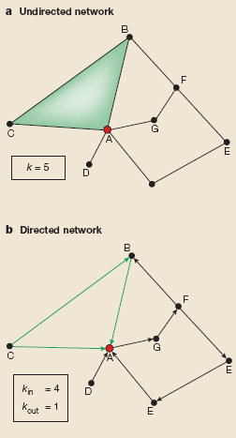
Complex Networks
The above approach is more or less heuristic and is based on trial and error. What is theoretical framework to understanding network behaviors?
Network measures
Degree/connectivity (k)
Degree distribution
Scale-free networks
Shortest path
Six degrees of separation (S. Milgram 1960s)
Small-world effect
Clustering coefficient (C)
Average clustering coefficient of all nodes with k links C(k)
[12]

Slide 14
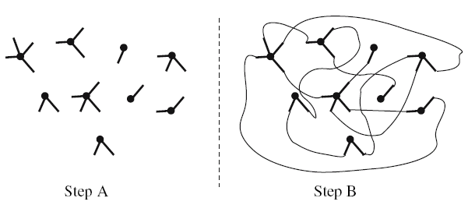
Complex Networks
Network models
Random graphs (ER model)
Start with N nodes and connect each pair of nodes with prob. p
Node degrees follow a Poisson distribution
Generalized random graphs (with arbitrary degree distribution)
Assign ki stubs to every vertex i=1,2,…,N
Iteratively choose pairs of stubs at random and join them together
Scale-free networks (evolution of networks)
Start with m0 unconnected vertices
Growth: add a new vertex with m
stubs at every time step
Preference attachment:
Hierarchical networks
Coexistence of modularity, local clustering, scale-free tology
Generalized random graphs [11]

Slide 15
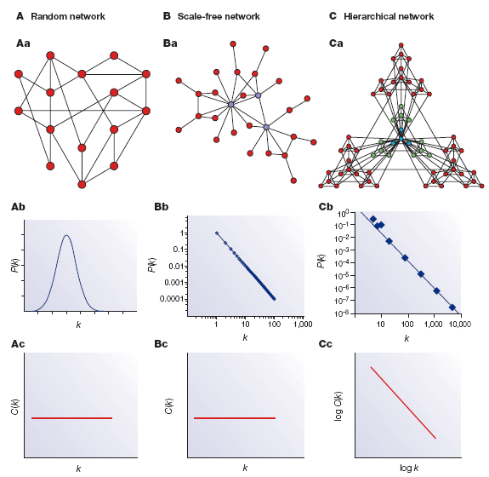
Complex Networks
[12]

Slide 16
Phenomena in Complex Networks: Phase Transition
Phase transition: as an external parameter is varied, a change occurs in the macroscopic behavior of the system under study [10].
Example: Emergence of giant component in generalized random graphs [13]
Degree distribution : pk
Outgoing degree distribution of neighbors:
With the aid of generating function, [13] derived distribution of component sizes. Specially, the average component size is
Diverges if , and a giant component emerges.
For random graphs, a giant component emerges if

Slide 17
Phenomena in Complex Networks: Synchronization
Synchronization: many natural systems can be described as a collection of oscillators coupled to each other via an interaction matrix and display synchronized behavior [10].
Application: distributed decision through self-synchronization [14]
xi(t): state of the system yi: measurement (e.g. temperature)
gi(yi): local processing unit K: global control loop gain
Ci: local positive coefficient aij: coupling among nodes
h: coupling function w(t): coupling noise
: propagation delay

Slide 18
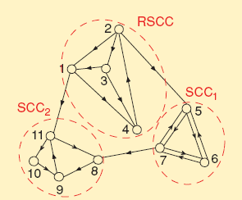
Phenomena in Complex Networks: Synchronization
Form of consensus: when h(x)=x, system achieves synchronize if and only if the directional graph is quasi strongly connected (QSC) and
Example of QSC graph [14]

Slide 19
Dynamical Processes on Complex Networks
Epidemic spreading
SIR model
S: susceptible, I: infective, R: recovered
Fully mixed model
SIS model
Application in routing/data forwarding in mobile ad hoc networks [15]
Search in networks
Search in power-law random graphs [16]
Random walk
Utilizing high degree nodes

Slide 20
Further Research Topics
Cognition and knowledge construction/representation of humans
Information theoretical approach to local information
In general, we can model the observing/sensing process as a channel, what does the channel capacity mean?
What is relationship between channel capacity and statistical inference?
What are conditions that cooperative information helps (or they achieves consensus)?
Example: spectrum sensing in cognitive radio networks
Cooperative information
Global information
Observed local information
Equivalent channel model

Slide 21
Reference
[1] K. C. Chen, Cognitive radio networks, lecture note.
[2] M. Wang and T. Suda, “The bio-networking architecture: A biologically inspired approach to the design of scalable, adaptive, and survivable/available network application,”
[3] M. Margaliot, “Biomimicry and fuzzy modeling: A match made in heaven,” IEEE Computational Intelligence Magazine, Aug. 2008.
[4] M. Dorigo and T. Stutzle, Ant colony optimization, 2004.
[5] S. C. Nicolis, “Communication networks in insect societies,” BIOWIRE, pp. 155-164, 2008.
[6] S. Camazine, J. L. Deneubourg, N. R. Franks, J. Sneyd, G. Theraulaz, and E. Bonabeau, Self-organization in biological systems, 2003.
[7] E. Bonabeau, M. Dorigo, and G. Theraulaz, Swarm intelligence: From natural to artificial systems, 1999.
[8] J. Y. Le Boudec and S. Sarafijanovic, “ An artificial immune system approach to misbehavior detection in mobile ad-hoc networks,” Bio-ADIT, pp. 96-111, Jan. 2004.
[9] M. E. J. Newman, “The structure and function of complex networks,” 2003
[10] A. Barrat, M. Barthelemy, and A. Vespignani, Dynamical processes on complex networks, 2008
[11] C. Gros, Complex and adaptive dynamical systems, 2008.
[12] A-L Barahasi and Z. N. Oltvai, “Network biology: Understanding the cell’s function organization,” Nature Review, Feb. 2004.

Slide 22
Reference
[13] M. E. J. Newman, S. H. Strogatz, and D. J. Watts, “Random graphs with arbitrary degree distributions and their applications,” Physical Review E., 2001.
[14] S. Barbarossa and G. Scutari, “Bio-inspired sensor network design: Distributed decisions through self-synchronization,” IEEE Signal Processing Magazine, May 2007.
[15] L. Pelusi, A. Passarella, and M. Conti, “Opportunistic networking: Data forwarding in disconnected mobile ad hoc networks,” IEEE Communications Magazine, Nov. 2006.
[16] L. A. Adamic, R. M. Lukose, A. R. Puniyani, and B. A. Huberman, “Search in power-law networks,” Physical Review E., 2001.

